Slide 1
Adenoviridae
Baltimore Group I
Barthadenovirus (formerly Atadenovirus) occur in squamate reptiles, birds, ruminants, marsupials and tortoises
Aviadenovirus (Egg drop syndrome virus)
Ichtadenovirus- single fish adenovirus
Mastadenovirus (Canine adenovirus 1- ICH)
Siadenovirus - infect birds, frog and tortoise
Testadenovirus occur in turtles

Slide 2
Adenoviridae
Genera –
Mastadenovirus – Mammalian adenoviruses
Single penton fiber from vertex
Aviadenovirus – Avian adenoviruses
Each penton is bifurcated – giving the appearance of 2 fibers extending from each penton base
The adenoviruses are named after the human adenoids, from which they were first isolated.
Adenoviruses are popular virus vectors, for example in vaccination against the coronavirus SARS-CoV-2.

Slide 3
Virion Morphology
Virion shows penton fiber peplomers from the vertices
Penton fiber knobs contain cell binding ligands that are responsible for viral attachment to host cell receptors.
Associated with hemagglutinating activity.
Non-enveloped, icosahedral, 80-100 nm in diameter, 252 capsomers, 240 hexons occupying faces, and edges & 12 pentons occupying vertices.
Virus codes for about 40 different proteins and there are 13 structural proteins

Slide 4
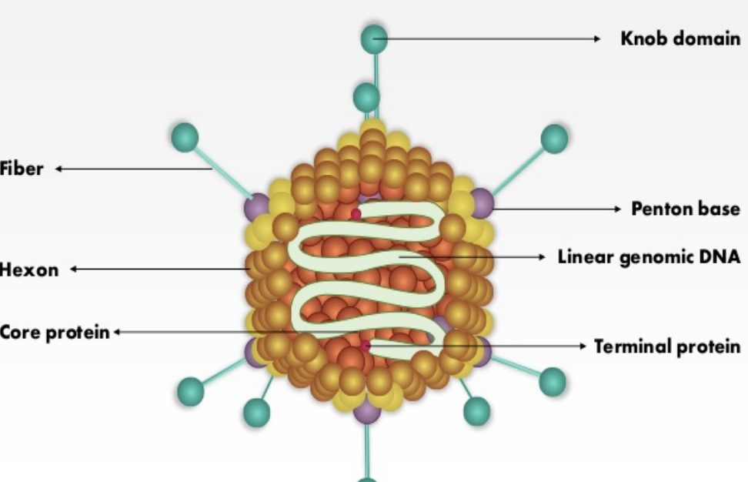

Slide 5
Viral Genome
The genome is not segmented and consists of a single molecule of linear double-stranded DNA.
The genome has a guanine + cytosine content of 48-61% for Mastadenovirus and 54-55% for Aviadenovirus.
The genome has terminally redundant sequences with inverted terminal repeats (ITR) varying in length from ~ 40 – 200 bp, where the origin of replication is present.
The genome has a virus coded terminal protein (TP) which is covalently linked to the 5'-end of each DNA strand.
The genetic organization of the central part of the genome is conserved throughout the family, whereas the terminal parts show large variations in length and gene content.

Slide 6
Viral Replication
Fiber attaches to specific receptor on the cell surface.
Receptors-Major histocompatibility complex (MHC) molecules and sialic acid residues
Virus is then taken into endocytotic pits (endocytosis) where it enters the cytoplasm.
In the cytoplasm pentons are removed and core moves to the nucleus via microtubules attached to the hexon capsomers.

Slide 7
In the nucleus the genome is transcribed by cellular RNA polymerase II according to a complex program involving both DNA strands and a number of primary transcripts are made.
The transcripts are spliced, capped, and polyadenylated, giving several different mRNAs.
These mRNA move to the cytoplasm.
The transcription is in two phases Early and late.

Slide 8
Adenovirus genes are organized into transcription units (TU).
The five early transcription units include early region 1A (E1A), E1B, E2, E3, and E4.
Intermediate transcription units, including IX, IVa2, L4 intermediate, and E2 late, are transcribed at the onset of DNA replication.
A single late transcription unit (major late) generates five populations of late mRNAs, L1–L5.
Most of the adenovirus transcription units are transcribed by RNA polymerase II and give rise to multiple mRNAs that are differentiated by alternative splicing or alternative poly(A) sites

Slide 9
E1A region of the viral genome codes for protein which has following three properties:
Induction of mitosis of cell.
To protect infected cells from host defence.
Synthesis of viral proteins for DNA replication.
Protein E1B targets a tumor suppressor protein p53
E1A and E1B products can cause cell transformation and oncogeneicity.
The E3 region is not essential for adenovirus replication in cell cultures and can be deleted or replaced without disrupting viral replication in vitro.
E3 proteins interact with host immune defense mechanisms thus modulating the host response to adenovirus infection

Slide 10
Once the early genes have liberated adequate virus proteins, replication of the adenovirus genome can occur.
Viral DNA replication uses a virus-encoded protein (TP) as a primer and another virus-encoded protein as DNA Polymerase.
In primate mastadenoviruses, there are one or two virus-associated (VA) RNA genes, which are transcribed by RNA polymerase III. These encode RNA products that facilitate translation of late mRNAs and block the cellular interferon response.
The late phase of the adenovirus life cycle is focused on producing sufficient quantities of structural protein to pack all the genetic material produced by DNA replication.

Slide 11
Once the viral components have successfully been replicated the virus is assembled in the nucleus into its protein shells.
Viruses are then released from the cell as a result of viral induced cell lysis.
Viral DNA replication, mRNA transcription and virion assembly occur in the nucleus, utilizing both host and virus-encoded factors. This results in the formation of basophilic and / or acidophilic intranuclear inclusions.

Slide 12
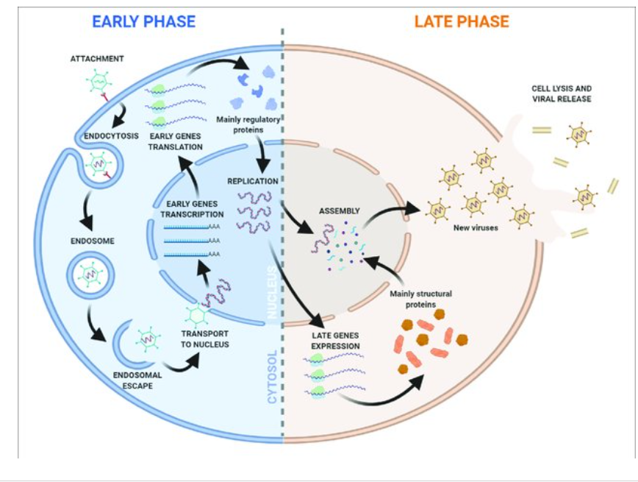

Slide 13
Adenoviridae - Pathogenesis
All adenoviruses- NARROW HOST RANGE – HIGHLY HOST SPECIFIC.
Numerous adenoviruses can cross host species barriers (reported recently)
Mostly subclinical infections with occasional URT infections, GI tract diseases
Virus persists in the pharyngeal region, particularly associated with the lymphoid tissues of respiratory tract and in the GALT tissues – enteric infections

Slide 14
Adenovirus – Infectious Canine Hepatitis (ICH)
The infection as encephalitis in enzootic form was reported by Green in 1925.
ICH was first described in dogs from Sweden by the veterinary scientist Carl Swen Rubarth in the 1940s and then worldwide reported in the following years also as “Rubarth’s disease”
He also distinguished it from Canine Distemper virus using ferrets that are resistant to ICH, but not to Canine Distemper.
Hosts – Family Canidae – domestic and wild,
Ursidae – bears and Mustelidae families (Otter, mink, ferrets)

Slide 15
Canine adenovirus species has been recently taxonomically renamed as Canine mastadenovirus A.
There are two important canine adenovirus infections caused by different canine adeno virus serotypes-
CAV-1: It causes Infectious Canine Hepatitis which may be acute or chronic, respiratory or occular disease, encephalopathy and interstitial nephritis.
CAV-2: CAV-1 is antigenically related to but distinct from CAV-2 - causes Infectious Canine Tracheobronchitis or kennel cough.

Slide 16
Disinfecting agents
STABLE VIRUS –
Stable in the environment .
Relatively resistant to disinfection (Alcohol, chlorhexidine, detergents) .
Stable in GI tract- can withstand low pH, bile acids and proteolytic enzymes
Susceptible to heat (steam cleaning) and disinfection by quaternary ammonium compounds.
CAV-1 is susceptible to iodine, phenol, NaOH and bleach

Slide 17
Transmission
Present in respiratory secretions, urine, feces, and saliva
Infection is by inhalation and ingestion. Spread is by direct and indirect contact.
Ingestion of urine, feces or saliva of infected dogs is the main route of infection.
It may be present in kidney and excreted in urine for 6-9 months post infection.
However, virus may be acquired via CONJUNCTIVAL OR AEROSOL ROUTES.

Slide 18
Pathogenesis
Upon entry through mouth or nose, the virus replicates initially in tonsils and Peyer’s patches (oropharyngeal lymph nodes) producing a viremia with secondary localization and replication in the liver (hepatocytes), endothelial cells within a variety of tissues occurs, such as the lungs, liver, kidneys, spleen, and eye with resultant hemorrhage, necrosis, and inflammation. .
The virions are released by cell lysis, which leads to tissue injury and disseminated intravascular coagulation (DIC)
Recovery from infectious canine hepatitis (ICH) results in lasting immunity.

Slide 19
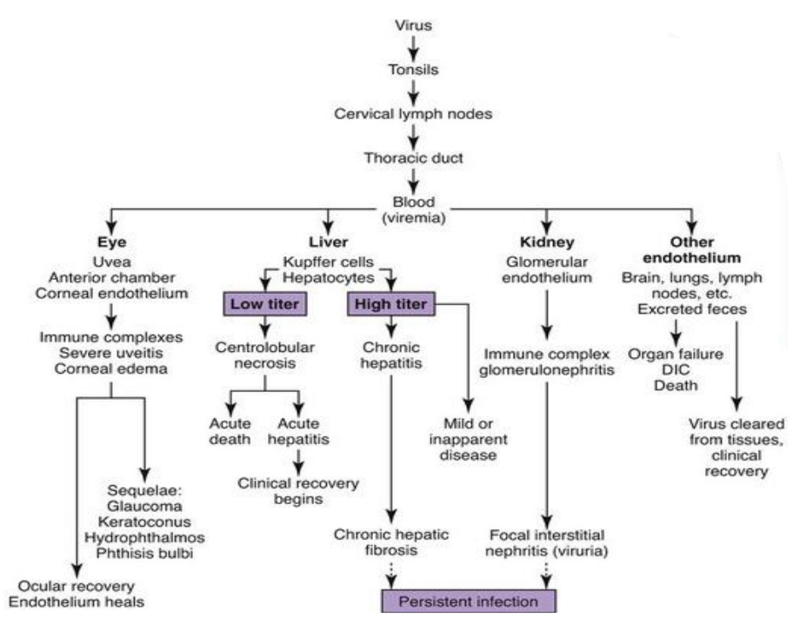

Slide 20
Clinical Forms
I.P from 4-10 days.
Course 5-7 days in uncomplicated cases and is long in presence of concurrent infection and in dogs with chronic active hepatitis.
Morbidity rate (less than 5%)
Mortality rate 10%–30%
1. Per acute form: Sudden death due to damage of vital organs as brain and lungs or due to shock or hepatic coma.
2. Acute form: Biphasic Fever “Saddle type curve“, anorexia, and thirst.
• Abdominal pain, vomiting and diarrhea.
• Petechiae of the oral mucosa, as well as enlarged tonsils.
• S/C edema of the head, neck, and trunk.
• Dogs with acute disease either recover or die within a 2-week period.

Slide 21
Hepatic involvement: Abdominal tenderness, distention due to serosanguinous ascites and hepatomegaly & icteric mucous membrane.
Non-suppurative encephalitis (uncommon) due to vascular damage of the brain tissue.
Eye involvement: Corneal edema, ulceration or perforation and anterior uveitis result in blepharospasm, photophobia and serous ocular discharge (transient uni or bilateral corneal opacity or blue eye).
Corneal edema (“blue eye”) occurs in the first week of illness and results from replication of virus within corneal endothelial cells
Conjunctivitis, serous discharge from the eyes and nose.
Death due to hepatic insufficiency and hepato-encephalopathy.

Slide 22
The chronic form - occurs in dogs with partial immunity, with death due to hepatic failure weeks (subacute disease) or months (chronic infection) after initial infection.
The antibody response appears 7 days after infection and limits tissue damage.
Viral persistence within the renal glomeruli, uveal structures of the eye (the iris and ciliary body), and the cornea can trigger immune complex formation in dogs that recover from acute illness.
This leads to glomerulonephritis with proteinuria, severe uveitis, and persistent corneal edema in some surviving dogs.
Glomerulonephritis usually occurs about 1 to 2 weeks after the acute signs resolve.

Slide 23
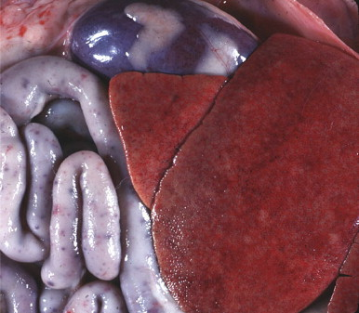
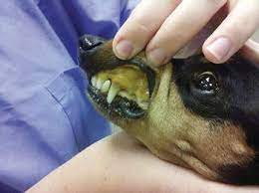
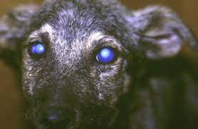
Clinical Signs
Notes:
Necrosis of liver and haemorrhages on other tissues.

Slide 24
Diagnosis
Diagnosis – Based on clinical signs, lab findings
Sample collection :- Urine, faces, saliva, ocular and nasal discharge in case of live animals
Spleen,lungs,lymph node,kidney in case of dead animals
Virus Cultivation:- Madin-Darby canine kidney cells (MDCK)
Adenoviruses infecting susceptible cells cause similar cytopathic effects, i.e., early rounding of cells and aggregation or lysis of chromatin, followed by the later appearance of characteristic eosinophilic or basophilic nuclear inclusions.
Serology:- ELISA test, VNT test, HI test
Molecular technique:- PCR

Slide 25
Immunity
Recovered animals are immune to the systemic form of the disease but may not resist an aerosol challenge and may develop respiratory disease
Maternal antibody interferes with active immunization until puppies are 9-12 weeks of age.
Vaccines should be administered every 3 to 4 weeks from 6 weeks of age, with the last vaccine given no earlier than 16 weeks of age
Both inactivated virus and attenuated/modified virus CAV-1 vaccines are used
Annual revaccination is recommended
Attenuated CAV-2 vaccines provide cross-protection against CAV-1

Slide 26
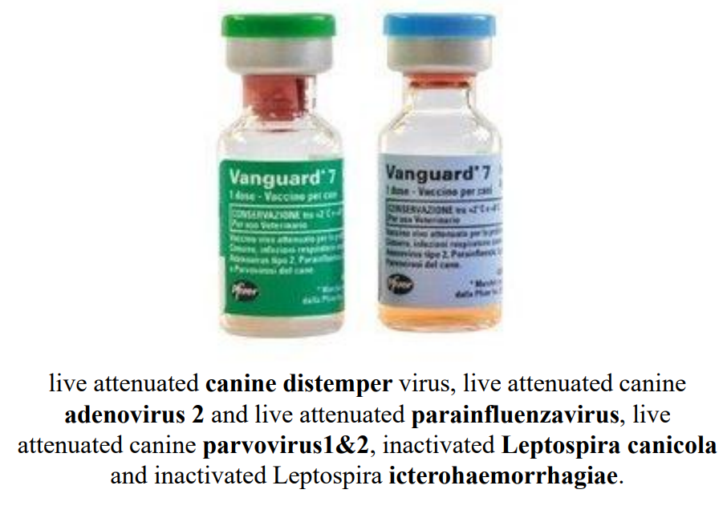

Slide 27
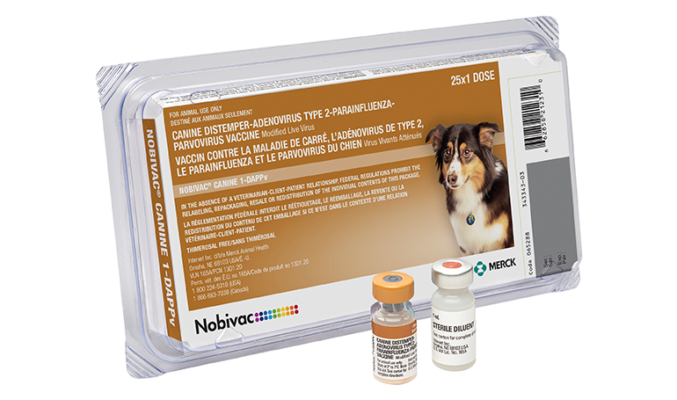

Slide 28
Canine Infectious Tracheobronchitis or Kennel cough
Kennel cough is mostly self-limiting respiratory disease of dogs
Etiologic agents – CAV-2, Canine parainfluenza 2, Bordetella bronchiseptica, Mycoplasma canis
Other contributing factors include – CAV-1 and Canine morbillivirus (canine distemper)
Transmission – highly contagious – via aerosols

Slide 29
Clinical Features –
IP – 30 days
Uncomplicated ITB
Mild respiratory disease – laryngitis, tonsilitis, pharyngitis, tracheitis, bronchitis
Paroxysms of dry, hacking, mostly nonproductive cough, followed by retching
Rhinitis with serous to mucopurulent nasal discharges

Slide 30
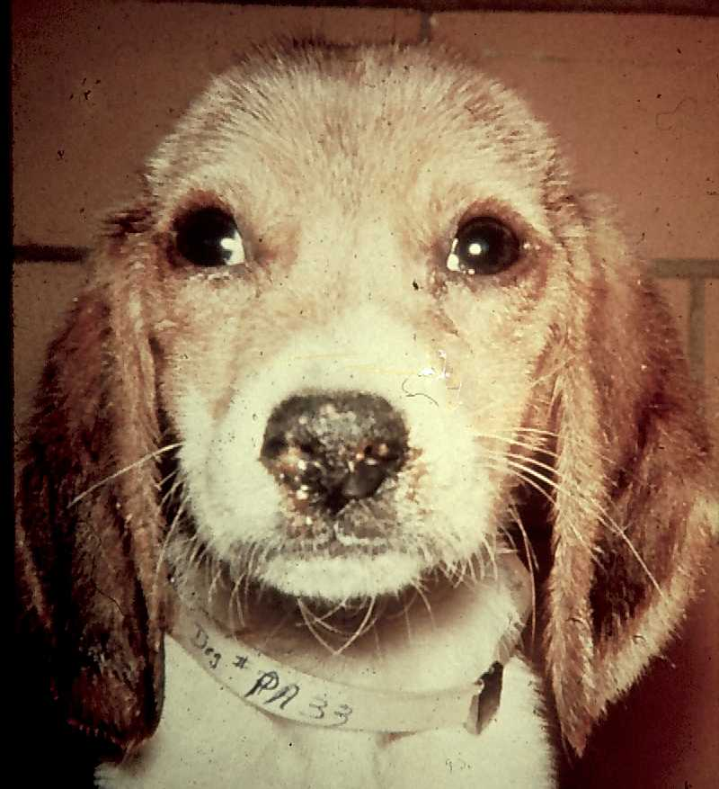
Canine Infectious Tracheobronchitis - ITB
Usually resolves in 2 weeks
Diagnosis – similar to CAV-1
Palpation of trachea stimulates coughing attack
Immunity – CAV-2 vaccination –MLV is routinely incorporated into vaccine protocols recommended for all dogs

Slide 31
Egg drop syndrome’ 76
Egg drop syndrome '76 is caused by duck atadenovirus A (formerly duck adenovirus A), a member of the genus Atadenovirus
The lesions are minimal and are confined to the reproductive tract of hens.
In these birds there may be inactive ovaries, atrophy of the oviducts, and edema and white exudates in the uterus (shell gland).
Laid eggs may be paler than normal, rough, thin-shelled, soft- shelled,or shell-less by apparently healthy chickens

Slide 32
Lesions in pouch shell glands and oviduct where epithelial cells of the uterus, isthmus, and vaginal gland region become necrotic and contain intranuclear inclusions
The main route of transmission is through contaminated eggs. Droppings also contain virus, and contaminated fomites such as crates or trucks can spread virus.
Vertical transmission thru eggs so detection of source is difficult.

Slide 33
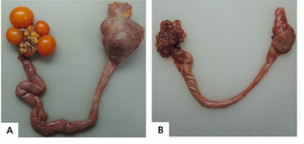
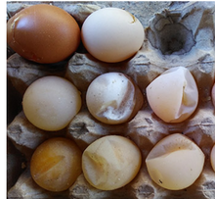
Abnormal eggs
A; normal hens' reproductive system B; inactive ovaries and shrunken oviducts

Slide 34
Diagnosis
Loss of egg production with abnormal eggshells suggest EDS
Serologic tests include hemagglutination inhibition using fowl RBC, ELISA, and serum neutralization.
Cultivation of Virus : Duck and goose embryonated eggs (preferred) and also in duck kidney or fibroblast cell lines.
The presence of virus is indicated by hemagglutination of avian red cells (HA test).
Diagnosis is made with the hemagglutination inhibition test (HI test). It is used to screen flocks but negative tests do not indicate that birds are necessarily free of infection.

Slide 35
Inclusion body hepatitis (Litchi disease) and Hepatitis Hydropericardium syndrome (HHS) (Angara disease)
It is a condition caused by Fowl adenovirus 4, possibly in combination with an RNA virus and immunosuppression caused by Chick Anaemia Virus or Infectious Bursal Disease.
The disease was initially reported from Angara Goth, Pakistan, and then from India during 1994, in the poultry belt of Jammu and Kashmir, and thereafter, from almost all parts of the country, causing heavy economic losses to the poultry industry.
The disease occurs predominantly in broilers of the age group of 3-5 weeks, characterized by sudden onset of high mortality up to 80%.
It is transmitted both vertically and horizontally

Slide 36
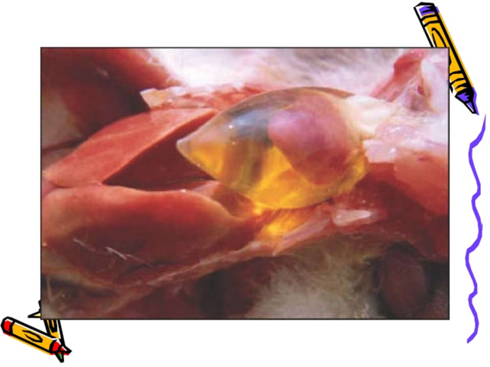
Signs
Sudden increase in mortality.
Lethargy.
Huddling with ruffled feathers.
Yellow mucoid droppings.
Post-mortem lesions
Excessive straw-coloured fluid distending the pericardium (up to 10 mls) -hydropericardium
Enlarged, pale friable liver containing multiple pale or hemorrhagic foci and enlarged kidney.
Congestion of the carcass.
Lungs oedematous.

Slide 37
